Slide 1
Jupyter Notebooks
For DBAs
Rob Sewell

Slide 2
This event was sponsored by Microsoft Learn more about SQL Server 2019 today: -Get free training: aka.ms/sqlworkshops -Download the SQL19 eBook: aka.ms/sql19_ebook

Slide 3
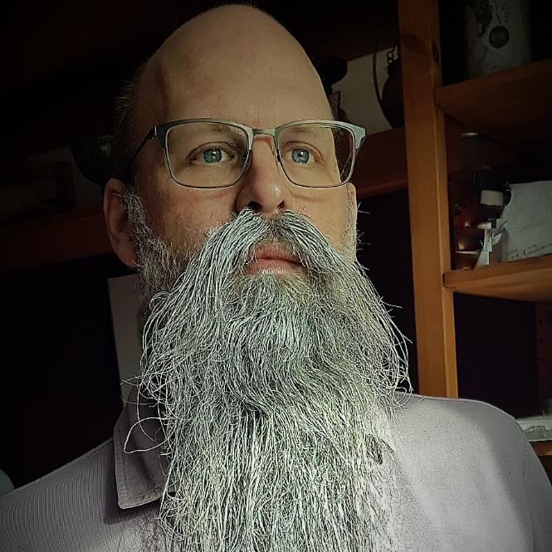
Rob Sewell
Consultant
MVP and Beard Twizzler
@SqlDbaWithBeard
beard.media/book – 40 % code twitsewe40

Slide 4
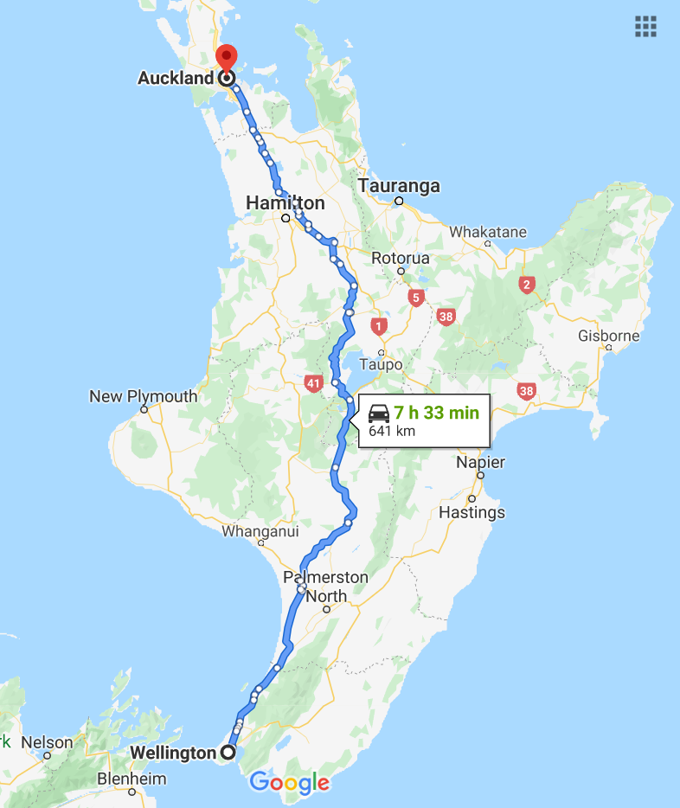

I live just outside Wellington

Slide 5
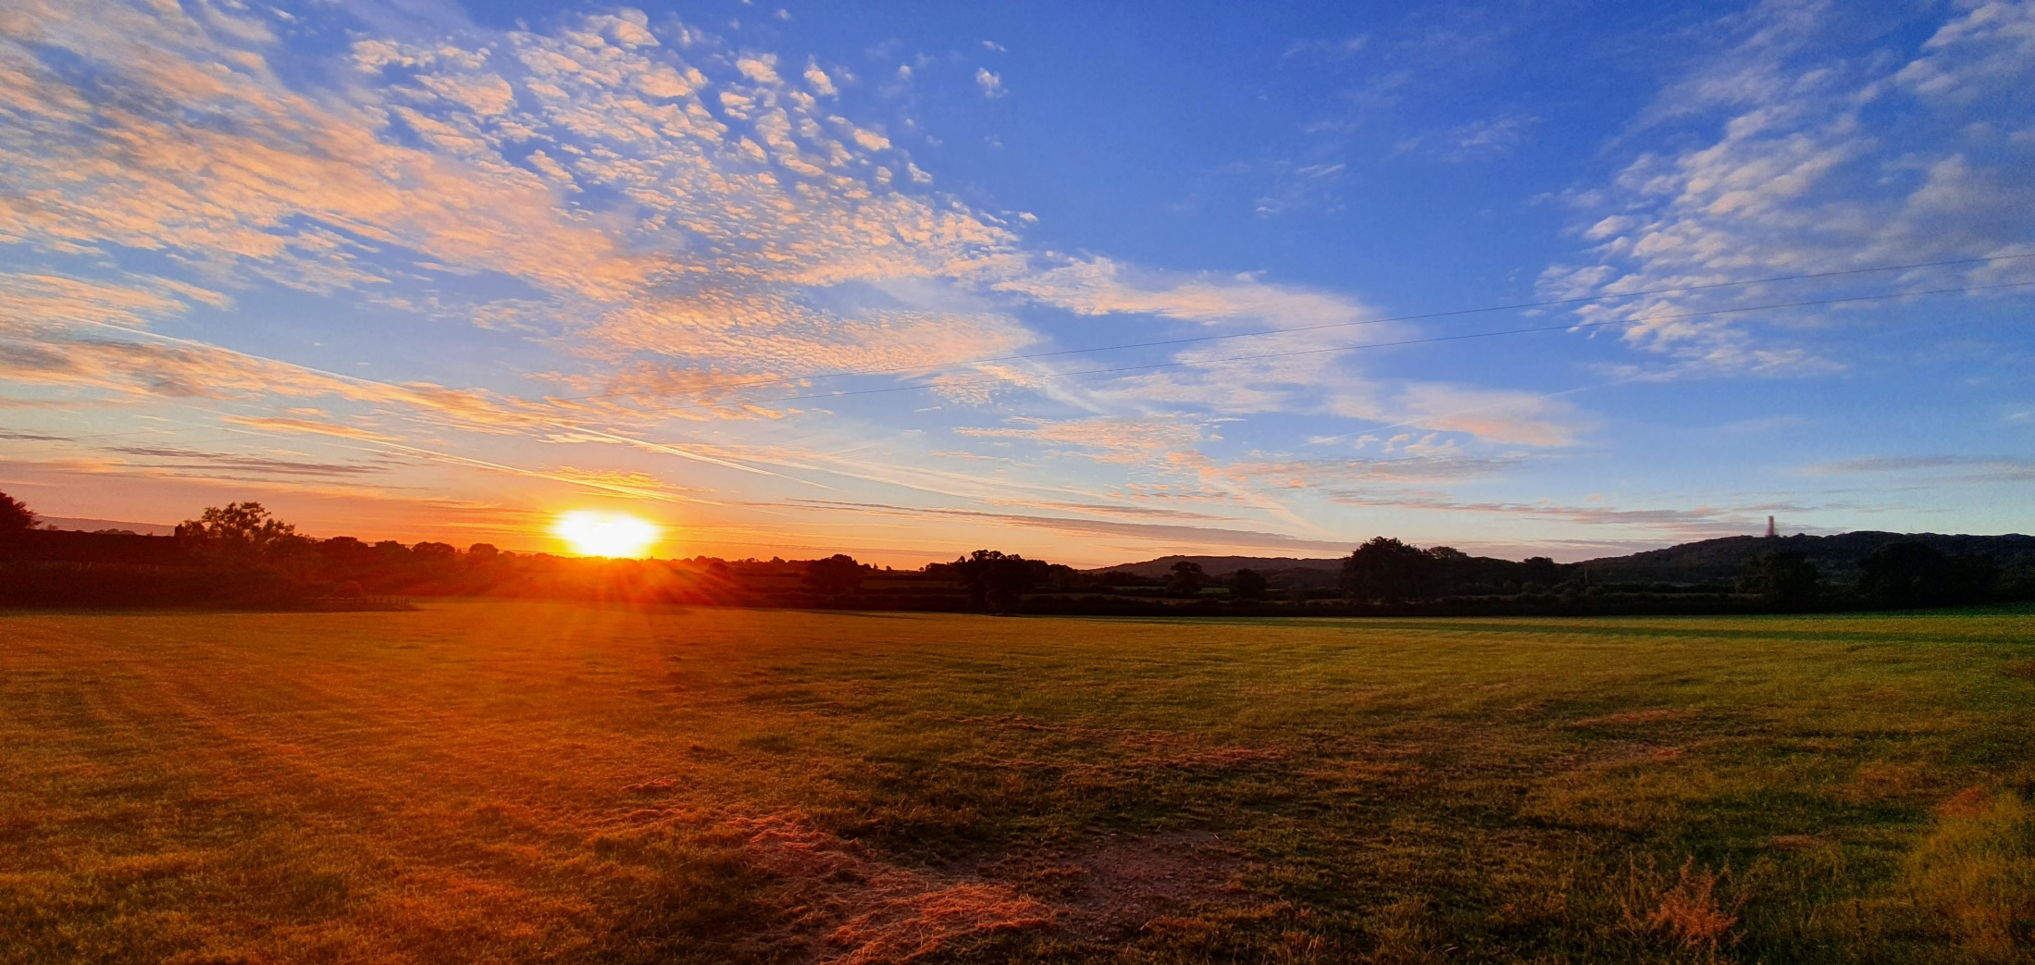
Not This Wellington!

Slide 6

Not This Wellington!

Slide 7
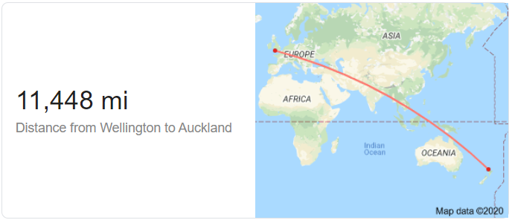
It’s a bit farther away!!

Slide 8
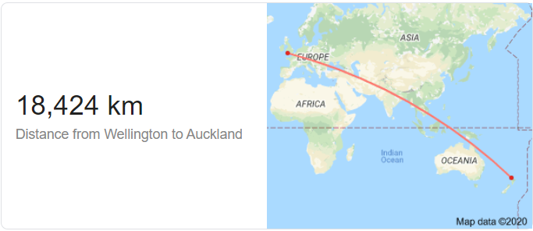
It’s a bit farther away!!

Slide 9





Thank you to our Global Sponsors and Supporters

Slide 10
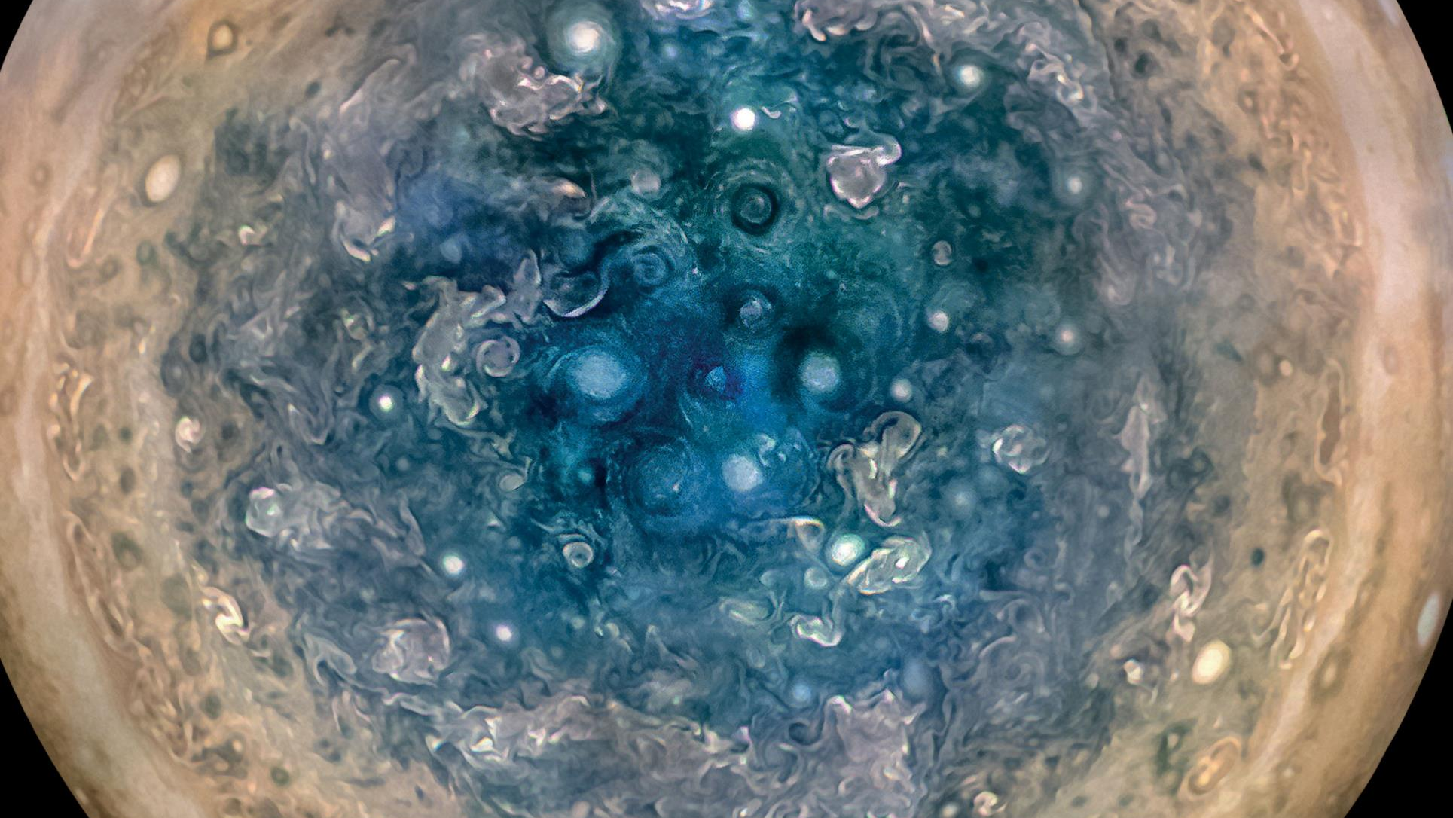

Slide 11
First, the names comes from the planet Jupiter. We wanted to pick a name that evoked the traditions and ideas of science.
Jupyter
@SQLDBAWithBeard SqlDbaWithABeard.com Rob Sewell beard.media/book

Slide 12
Jupyter
First, the names comes from the planet Jupiter. We wanted to pick a name that evoked the traditions and ideas of science.
Second, the core programming languages supported by Jupyter are Julia, Python and R. While the name Jupyter is not a direct acronym for these languages, it nods its head in those directions. In particular, the "y" in the middle of Jupyter was chosen to honor our Python heritage. See the logos of these languages in the languages folder of this repo.
https://github.com/jupyter/design/wiki/Jupyter-Logo
@SQLDBAWithBeard SqlDbaWithABeard.com Rob Sewell beard.media/book

Slide 13

We are thrilled to say the first ever PASS Virtual Summit will be taking place this November!
We will be launching PASS Summit into a whole new world, and with that comes exciting opportunities with what we can offer you. We will go beyond simply moving sessions online to fully embracing everything a virtual environment can offer.
Find out more at PASS.org/summit

Slide 14
Jupyter
Second, the core programming languages supported by Jupyter are
Julia, Python and R.
While the name Jupyter is not a direct acronym for these languages, it nods its head in those directions.
In particular, the "y" in the middle of Jupyter was chosen to honor our Python heritage.
Third, Galileo was the first person to discover the moons of Jupiter. His publication on the moons of Jupiter is an early example of research that includes the underlying data in the publication. This is one of the core ideas and requirements for scientific reproducibility. Reproducibility is one of the main focuses of our project.
https://github.com/jupyter/design/wiki/Jupyter-Logo
@SQLDBAWithBeard SqlDbaWithABeard.com Rob Sewell beard.media/book

Slide 15
Jupyter
Third, Galileo was the first person to discover the moons of Jupiter. His publication on the moons of Jupiter is an early example of research that includes the underlying data in the publication.
This is one of the core ideas and requirements for scientific reproducibility. Reproducibility is one of the main focuses of our project.
https://github.com/jupyter/design/wiki/Jupyter-Logo
@SQLDBAWithBeard SqlDbaWithABeard.com Rob Sewell beard.media/book

Slide 16
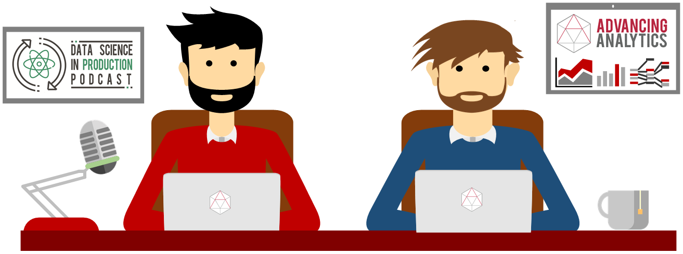
What is a Jupyter Notebook?
Originally for Data Scientists

Slide 17


Slide 18

Missed PASS Summit 2019?
Get the Recordings
Download all PASS Summit sessions on Data Management, Analytics, or Architecture for only $399 USD
More options available at PASSstuff.com

Slide 19
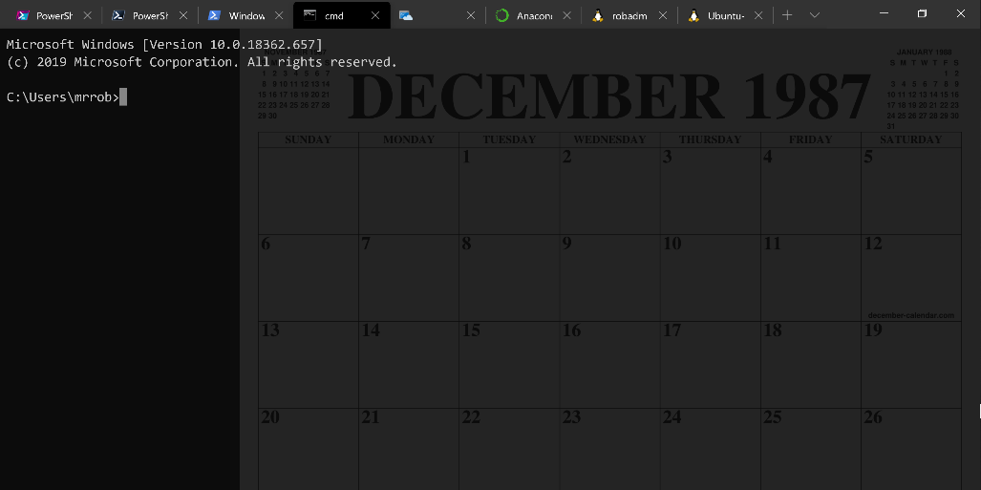
Running Queries
@SQLDBAWithBeard SqlDbaWithABeard.com Rob Sewell beard.media/book

Slide 20
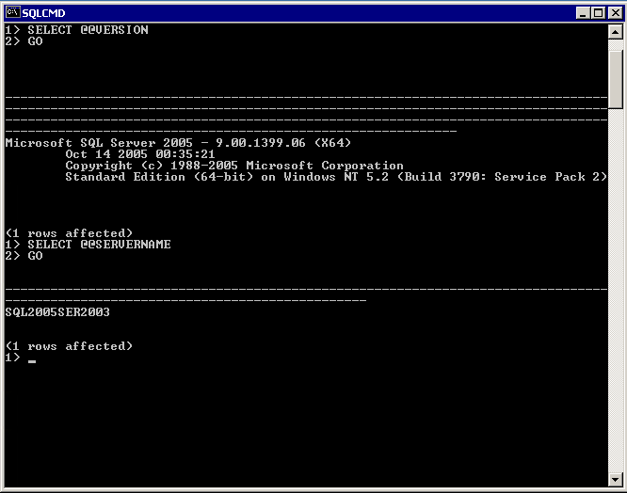
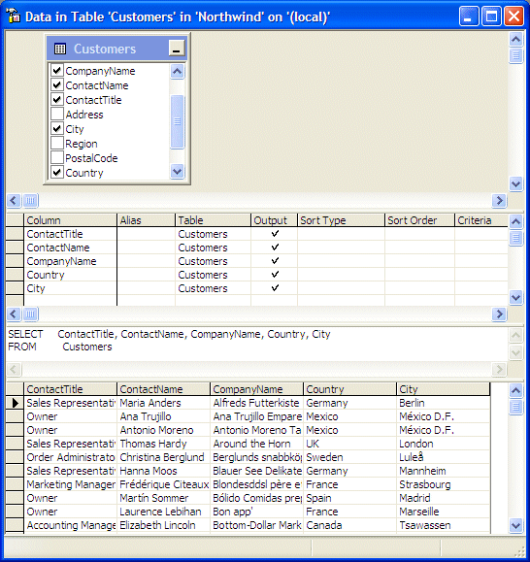
@SQLDBAWithBeard SqlDbaWithABeard.com Rob Sewell beard.media/book

Slide 21
Two and a Half Decades

Slide 22
Uh, Houston, we've had a problem
https://en.wikipedia.org/wiki/Houston,_we_have_a_problem
@SQLDBAWithBeard SqlDbaWithABeard.com Rob Sewell beard.media/book

Slide 23
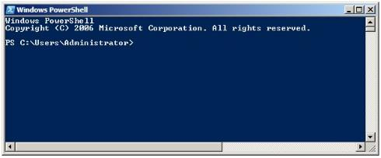
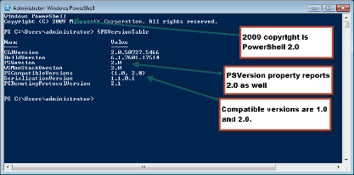
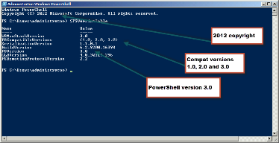
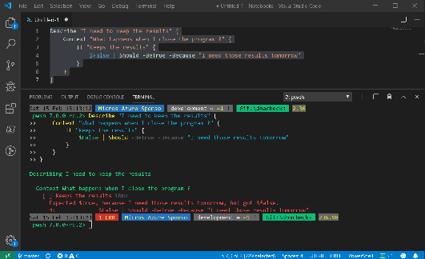
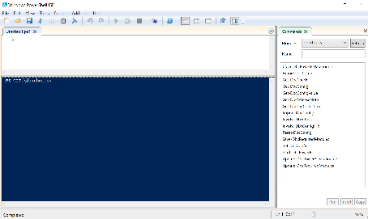
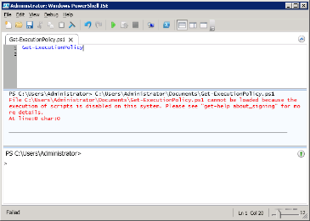
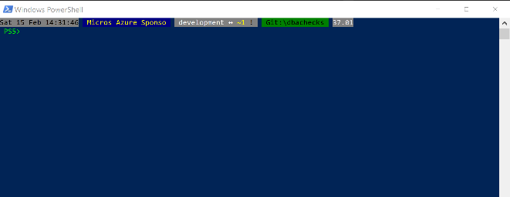
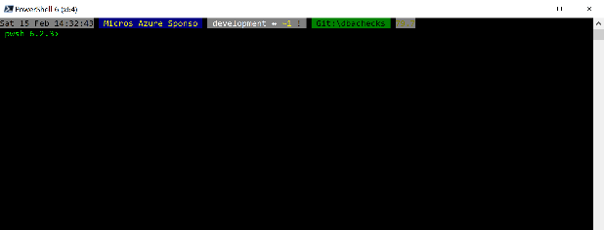
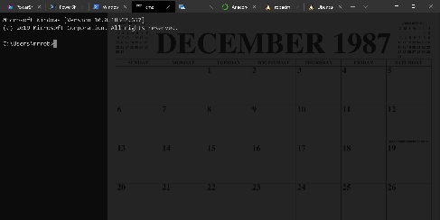
Without some effort………..

Slide 24
Without some effort………..
@SQLDBAWithBeard SqlDbaWithABeard.com Rob Sewell beard.media/book

Slide 25
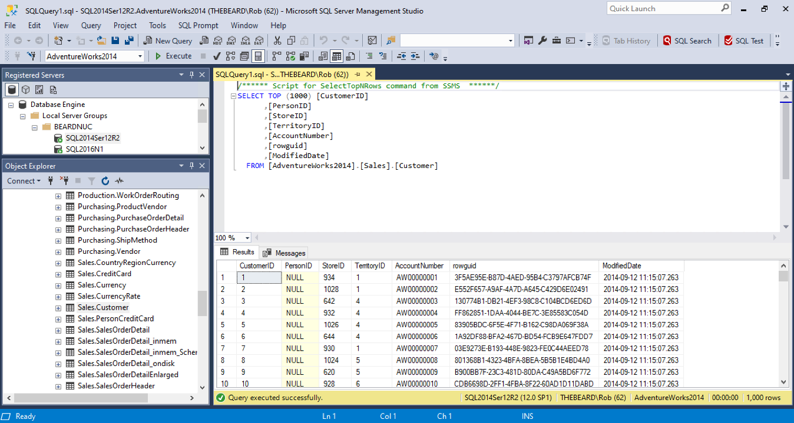

Slide 26
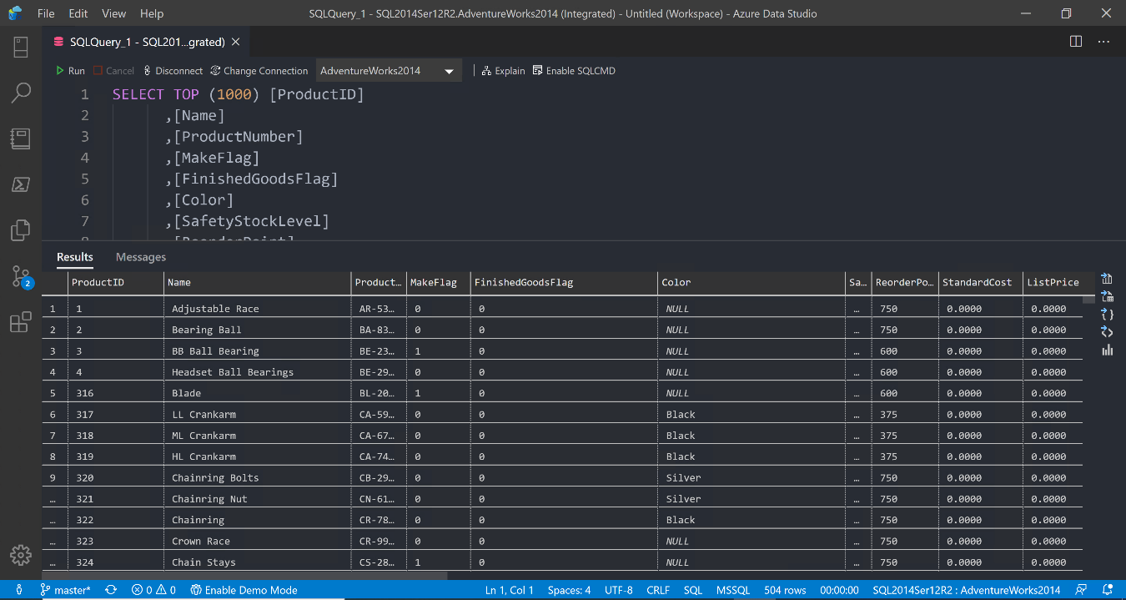

Slide 27
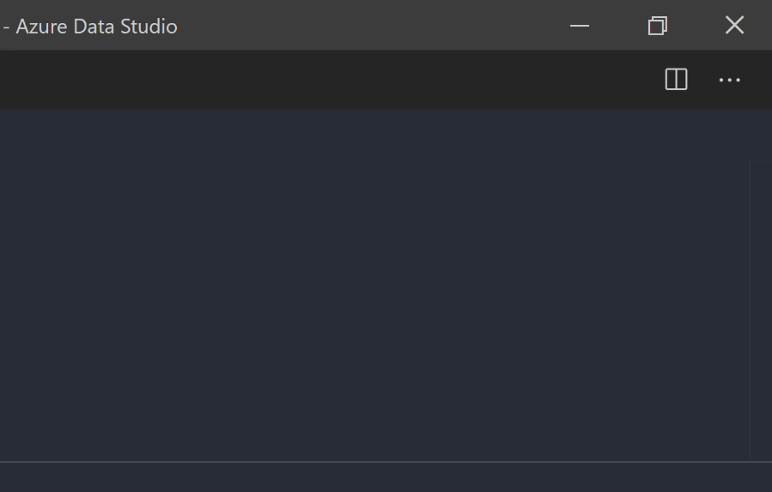
@SQLDBAWithBeard SqlDbaWithABeard.com Rob Sewell beard.media/book

Slide 28
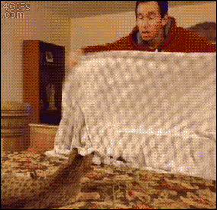
@SQLDBAWithBeard SqlDbaWithABeard.com Rob Sewell beard.media/book

Slide 29

@SQLDBAWithBeard SqlDbaWithABeard.com Rob Sewell beard.media/book

Slide 30
ALL
GONE
@SQLDBAWithBeard SqlDbaWithABeard.com Rob Sewell beard.media/book

Slide 31
What is a Jupyter Notebook?
Originally for Data Scientists

Slide 32
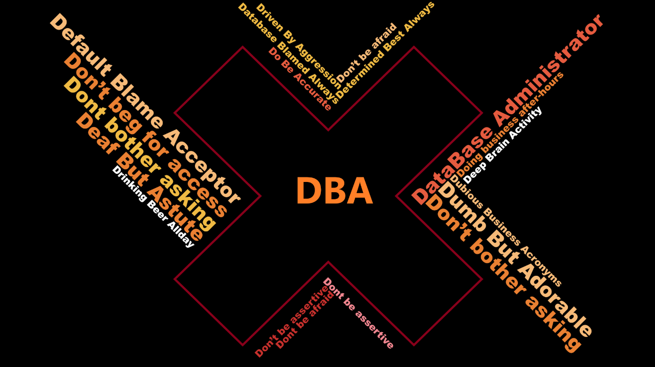

Slide 33
What is a Jupyter Notebook?
Document that can contain text, code, images and query results
@SQLDBAWithBeard SqlDbaWithABeard.com Rob Sewell beard.media/book

Slide 34
What is a Jupyter Notebook?
Document that can contain text, code, images and query results
@SQLDBAWithBeard SqlDbaWithABeard.com Rob Sewell beard.media/book

Slide 35
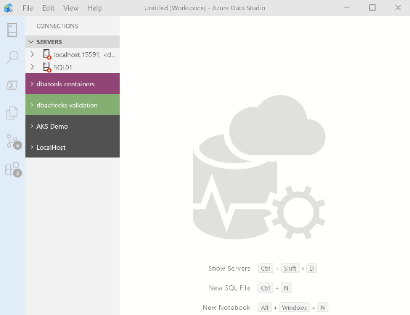
What’s Azure Data Studio ?
Cross Platform desktop environment for Data Professionals
@SQLDBAWithBeard SqlDbaWithABeard.com Rob Sewell beard.media/book

Slide 36

So it’s only for Azure?
@SQLDBAWithBeard SqlDbaWithABeard.com Rob Sewell beard.media/book

Slide 37
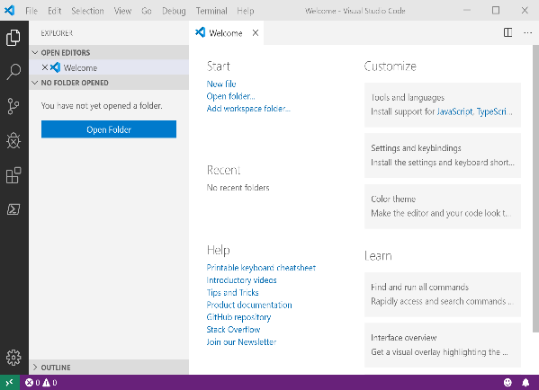
It Looks Like Visual Studio Code ?
@SQLDBAWithBeard SqlDbaWithABeard.com Rob Sewell beard.media/book

Slide 38
It Looks Like Visual Studio Code ?
@SQLDBAWithBeard SqlDbaWithABeard.com Rob Sewell beard.media/book

Slide 39

Time For A DEMO

